Slide 1
Designing Better Experiences for Users
Checklist for Page Design
Notes:
Designing Better Experiences for Users
Checklist for Page Design

Slide 2
Why use this checklist?
Anchor your page design on solving user goals and achieving business outcomes
Notes:
Why use this checklist?

Slide 3
Checklist for page design
What is this page about?
Who are the main target users for the page?
What are the user goals?
What problem will this service/information solve for the user?
What are the business objectives?
What is the main call to action for the user?
What are the secondary actions on the page?
Notes:
Checklist for page design
What is this page about?
Who is the main target user for the page?
What are the user goals?
What problem will this service/information solve for the user?
What are the business objectives?
What is the main call to action for the user?
What are the secondary actions on the page?

Slide 4
What is this page about?
Notes:
What is this page about?
Users will want to know what type of information or service they can get when they land on your page before they decide to continue exploring your content.
-The main header title indicates to the user what content will be found on this page.
-Use <h1> tag for your page title. This will help create a page structure that is clear with a top level heading.
-Relevant images are also used to provide an indicator as to what kind of content will be will be found on the page. Avoid using generic image content that is not related to your content.
These elements help the user to determine if this is the right page they are looking for on Calgary.ca, or if they should take another action such as search or navigation to find the content they want.

Slide 5
Who are the main target users for the page?
Notes:
Who are the main target users for the page?
Different audiences may have different needs, technology skill levels, and background.
Adjust your content and UI to match your target audience needs and skill level.

Slide 6
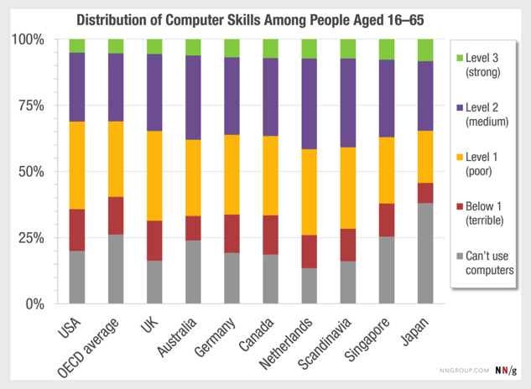
User computer skill levels
Source: The Distribution of Users’ Computer Skills: Worse Than You Think – Nielsen Norman Group
Notes:
User computer skill levels
Different users have varying levels of computer skill level.
Don’t forget, you are not the user. And your computer skill level is higher than many users for your content.
For broad user audience target level 1 and lower. (capable of tasks with widely available and familiar technology)
Research study conducted by OECD (Organisation for Economic Co-operation and Development). This international research study allows us to quantify the computer skill level difference advanced users and beginners.
Data was collected from 2011–2015 in 33 countries and was published in 2016. In total, 215,942 people were tested, with at least 5,000 participants in most countries.

Slide 7
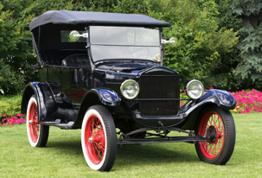
User goals stay consistent over time
Goal: Travel across the country as quickly and comfortable as possible
Notes:
User goals stay consistent over time
User goals are not dependent on the technology platform and are stable over long periods of time.
They can be aspirational for the user.
Example User Goal:
Traveling across the country as quickly and comfortable as possible.
Back in 1908, when you wanted to go across the country you might have chosen this Model T car.
Today, you might fly across the country in an airplane.
The goal is the same, but the tasks are different from each one.

Slide 8
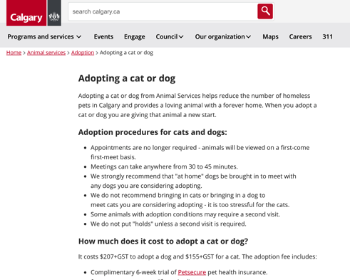
What are the user goals?
Example: Adopting a cat or dog
User Goals
Love
Companionship
Health
Notes:
User goals
Example: Adopting a cat or dog
User goals such as these are long term and stable. They are not dependent on technology or the platform in use.
They can be aspirational for them.
Example user goals:
Love
Companionship
Health

Slide 9
What problem will this service/information solve for the user?
Example: Adopting a cat or dog
User Goals
Love
Companionship
Health
Task
Find a pet
License a pet
Visit Animal Services
Find out cost
Comply with bylaws
Adoption process
Notes:
What problem will this service/information solve for the user?
Think about the type and number of tasks the user will need to do in order for them to accomplish their user goal.
List out the tasks and organize them using page layout methods in today’s training to provide hierarchy and structure.
This will help the user process the information needed to complete tasks required.

Slide 10
What are the business objectives?
Example business objectives:
Compliance with regulations
Education of user
Reduce calls to 311
Program objectives
Notes:
What are the business objectives?
Compliance with regulations
Education of user
Reduce calls to 311
Program objectives
Etc.

Slide 11
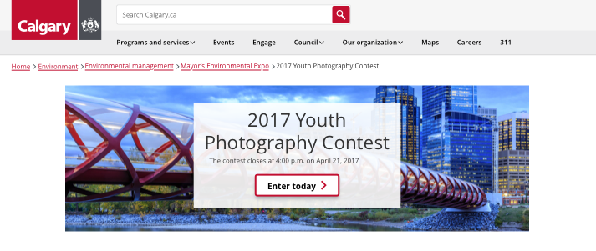
What is the main call to action for the user?
What do you want the user to do?
Notes:
What is the main call to action for the user?
Use the Primary Action Buttons to indicate to the user the main call to action on your page.
Too many call to actions can dilute your message and create confusion for the user.
Use the size of the button to indicate importance for the action.

Slide 12
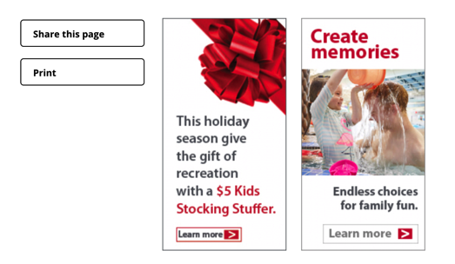
What are the secondary actions on the page?
Things a user can do?
Notes:
What are the secondary actions on the page?
Secondary action buttons allow the user to do something but is not the primary action or purpose of the page.
They are usually related to task type functionality or minor call to actions.

Slide 13
Bottleneck is user cognitive load
The main bottleneck is the maximum cognitive load a user can handle
Content
and
Services
Calgary.ca
Pages
Information
&
Interaction
Notes:
Bottleneck is user cognitive load
Total amount of mental processing power needed to process the information and interact with your page. This affects how easy task completion is on your page.
Psychology principles that determine amount of cognitive load:
Hick’s Law - The time it takes a person to make a decision as a result of the possible choices he or she has
Fitts' Law - The time required to quickly move to a target area is determined by a ratio between the distance to target and the width of the target.
Gestalt Theory
Number of steps in process
Length of steps in the process
Difficulty of steps in the process
Inattentional blindness

Slide 14
Use page design to shift the cognitive load away from the user
Your Content
Page
Notes:
Use the page design to shift the cognitive load away from the user
Think about where the cognitive load is when your creating your page layouts.

Slide 15
Thank you
Design better pages and
Create better user experiences for users
Notes:
Thank you
Design better pages and
Create better user experiences for users

